Slide 1

How to improve coding and research quality by thinking like a software developer
21st May 2025
Psychiatry Seminar
Amelia Edmondson-Stait

Slide 2






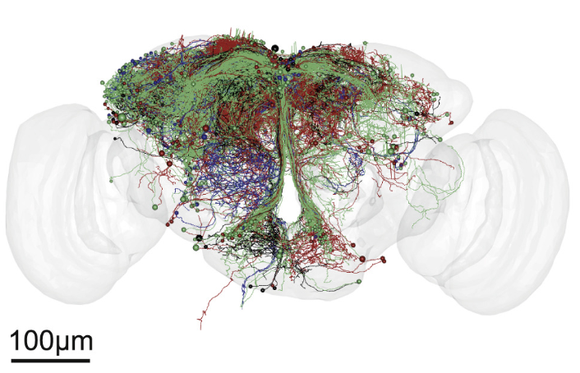







My coding journey
2016
Research Assistant
2019
PhD
2024
Post-doc
Self-taught coder &
run a coding club
1/18

Slide 3
Can we improve code quality by thinking like a software developer?
Things we don’t know
We don’t know
things we know we don’t know
things we know
2/18

Slide 4
Can we improve code quality by thinking like a software developer?
Code review &
Writing modular code
2/18

Slide 5
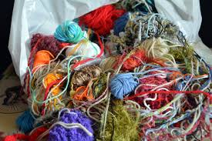

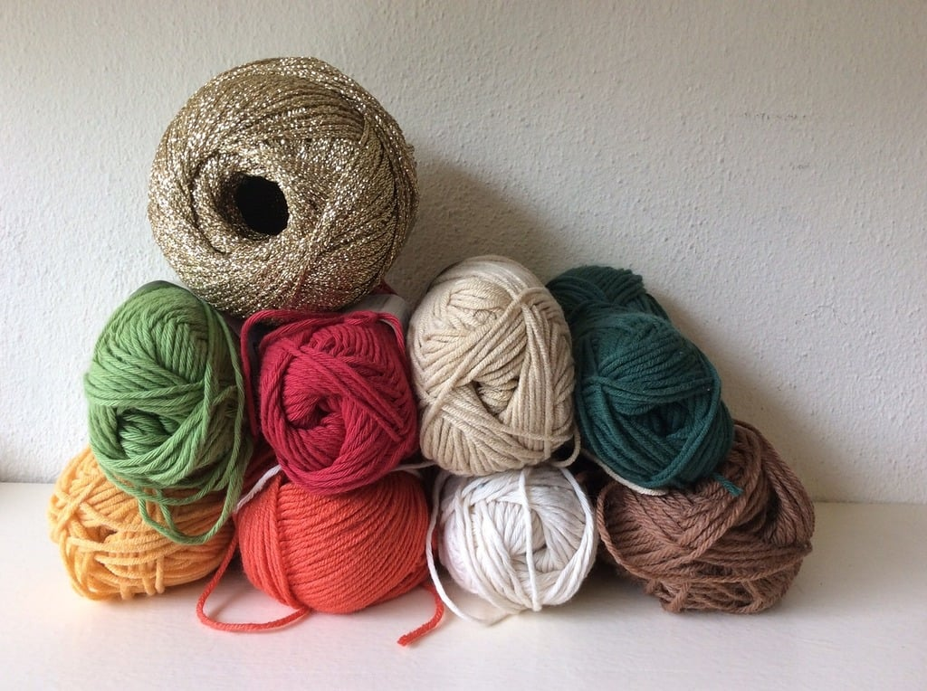

Why care about writing good quality code?
Good quality research relies on writing good quality code
3/18

Slide 6
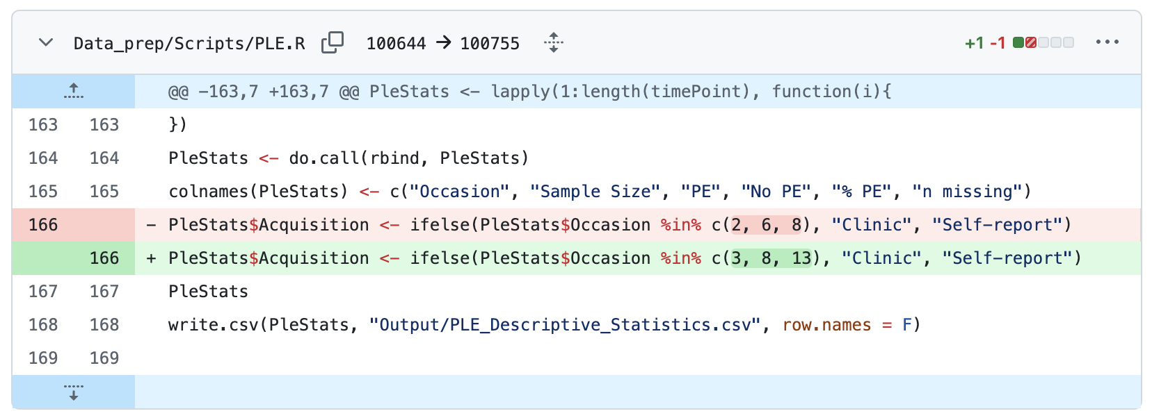
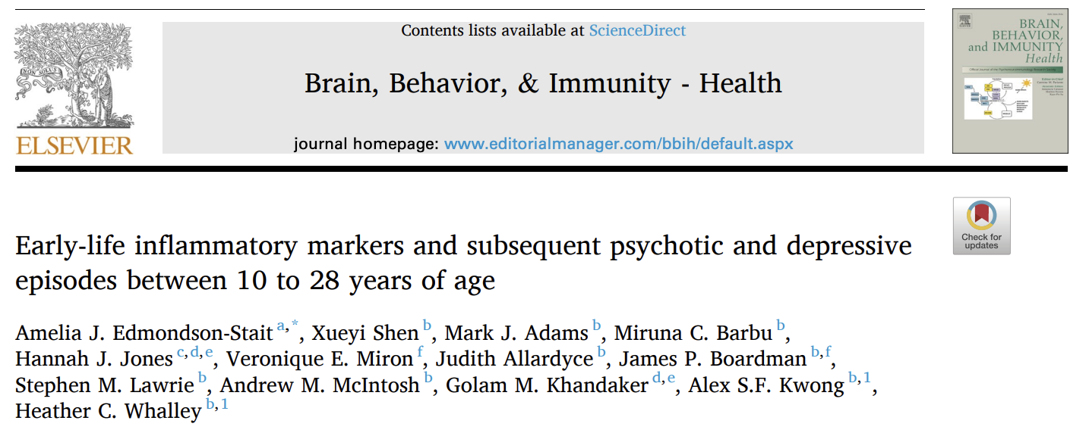
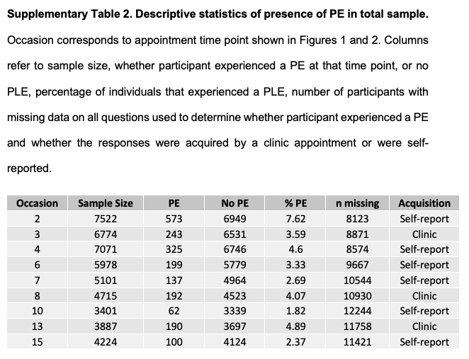
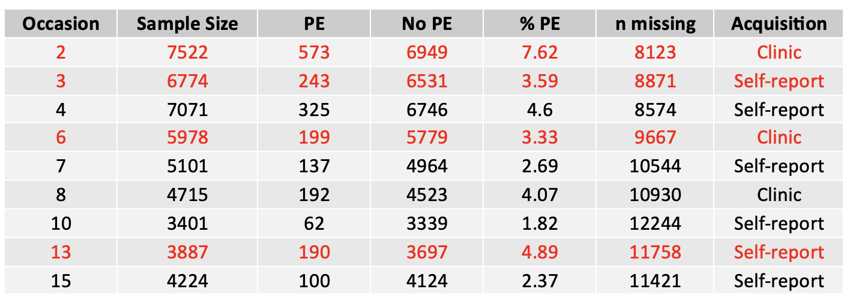
Everyone who codes makes mistakes in their code
How can we improve noticing and fixing these mistakes?
4/18
Notes:
It would be strange to not be making mistakes.
So how can we spot these mistakes so they don’t lead to misleading results?

Slide 7
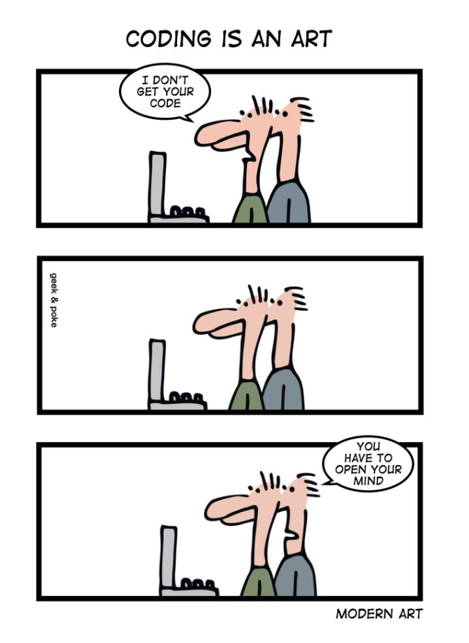
Code Review
Someone else looking over your code and checking it
Over-the-shoulder review
Asynchronous code review
Includes pull requests
5/18
Notes:
They don’t need access to data to do a code review. Code can be reviewed without being run.
Any coding experience is fine.
PR = request to merge changes from one git branch into another

Slide 8
Why code review is worth our time
We expect papers to be peer reviewed,
but our code is not reviewed...
6/18

Slide 9
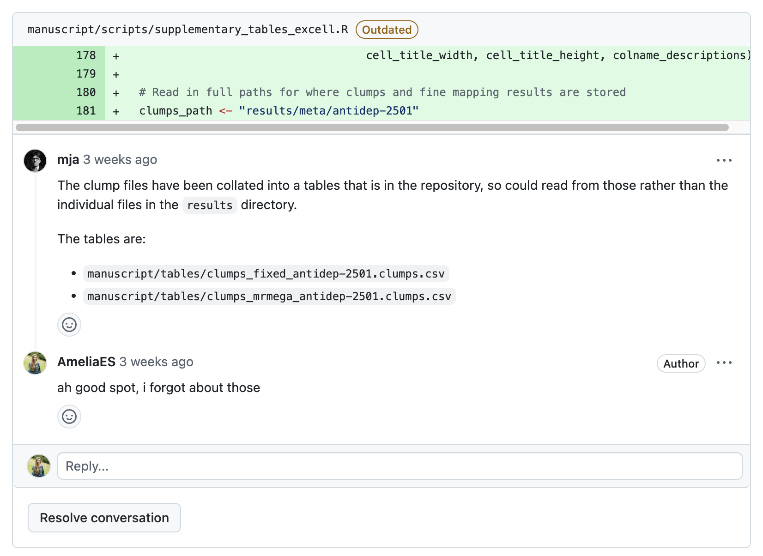
1. Improve code quality → research quality
7/18

Slide 10
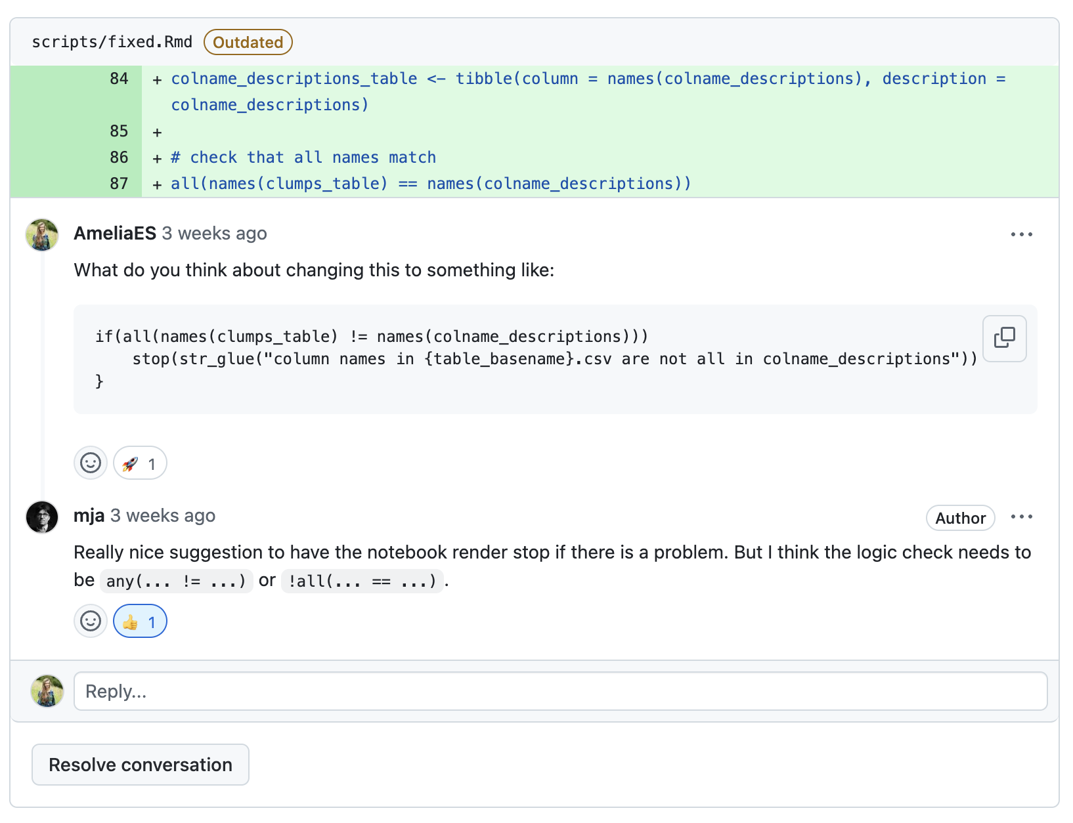
1. Improve code quality → research quality
8/18

Slide 11
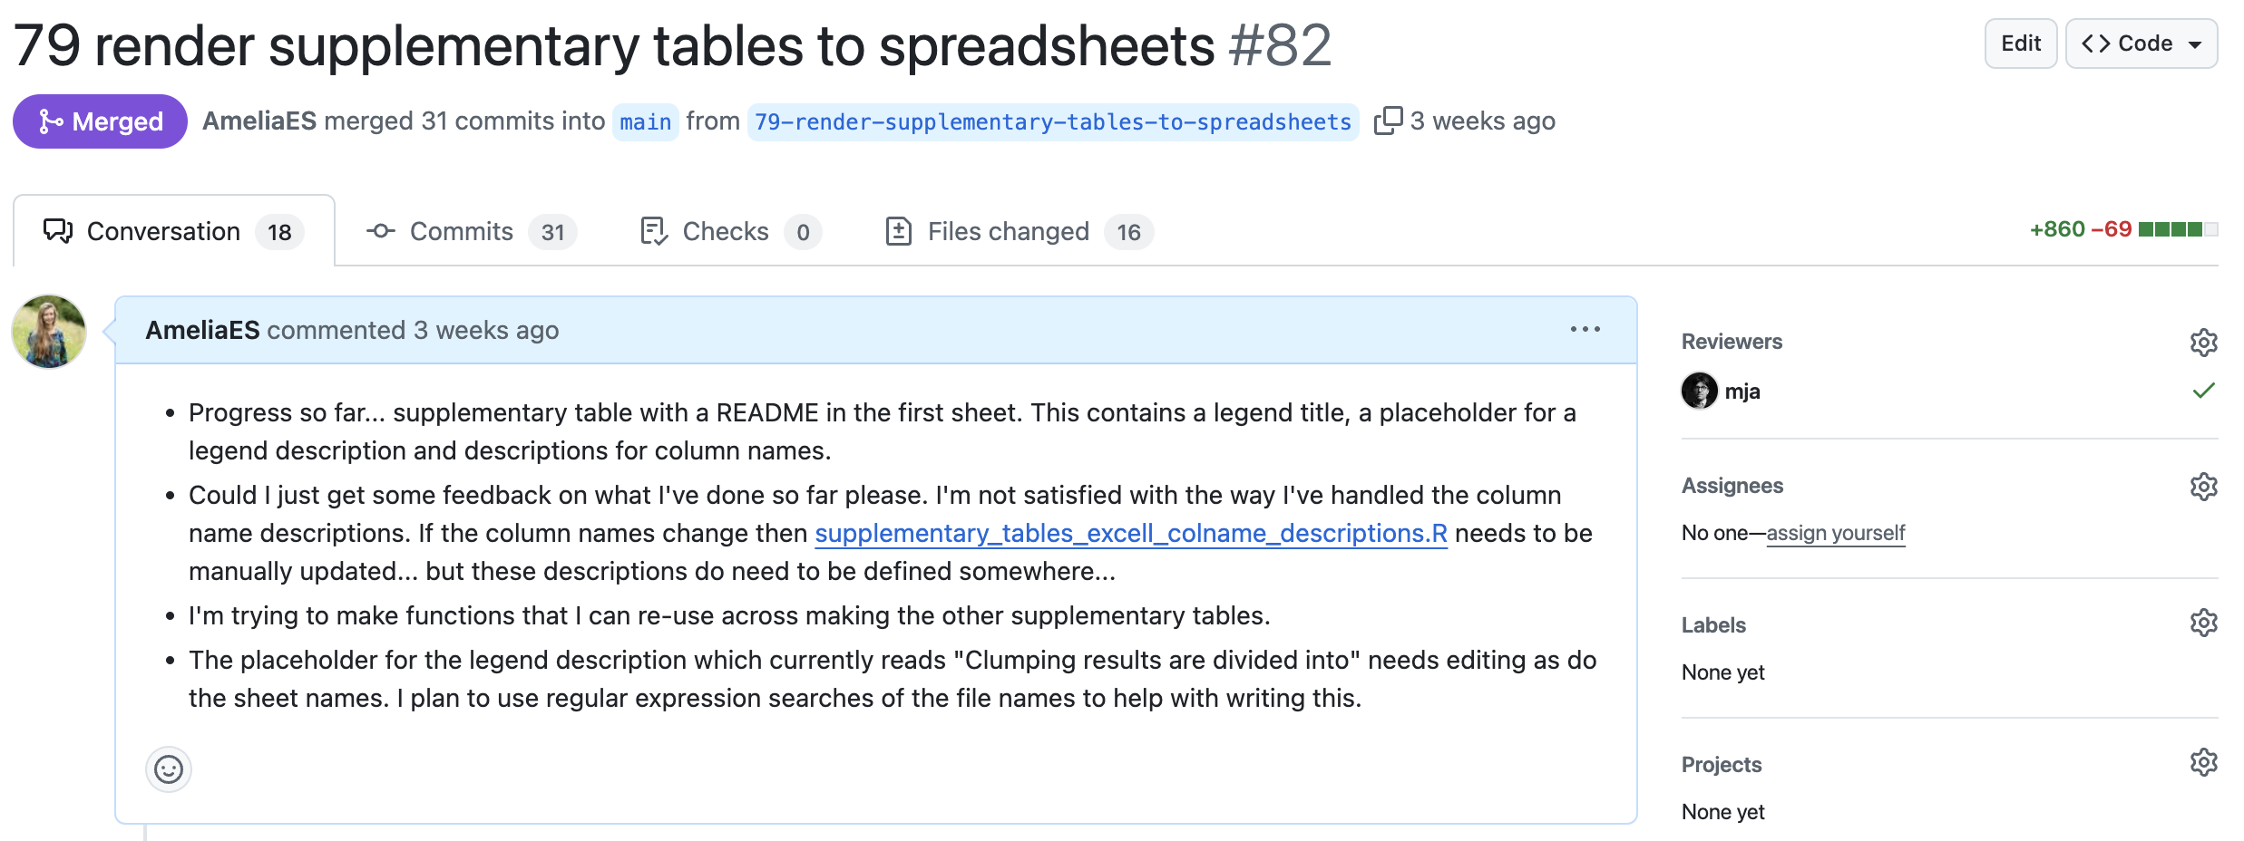
2. Solve problems together
9/18

Slide 12
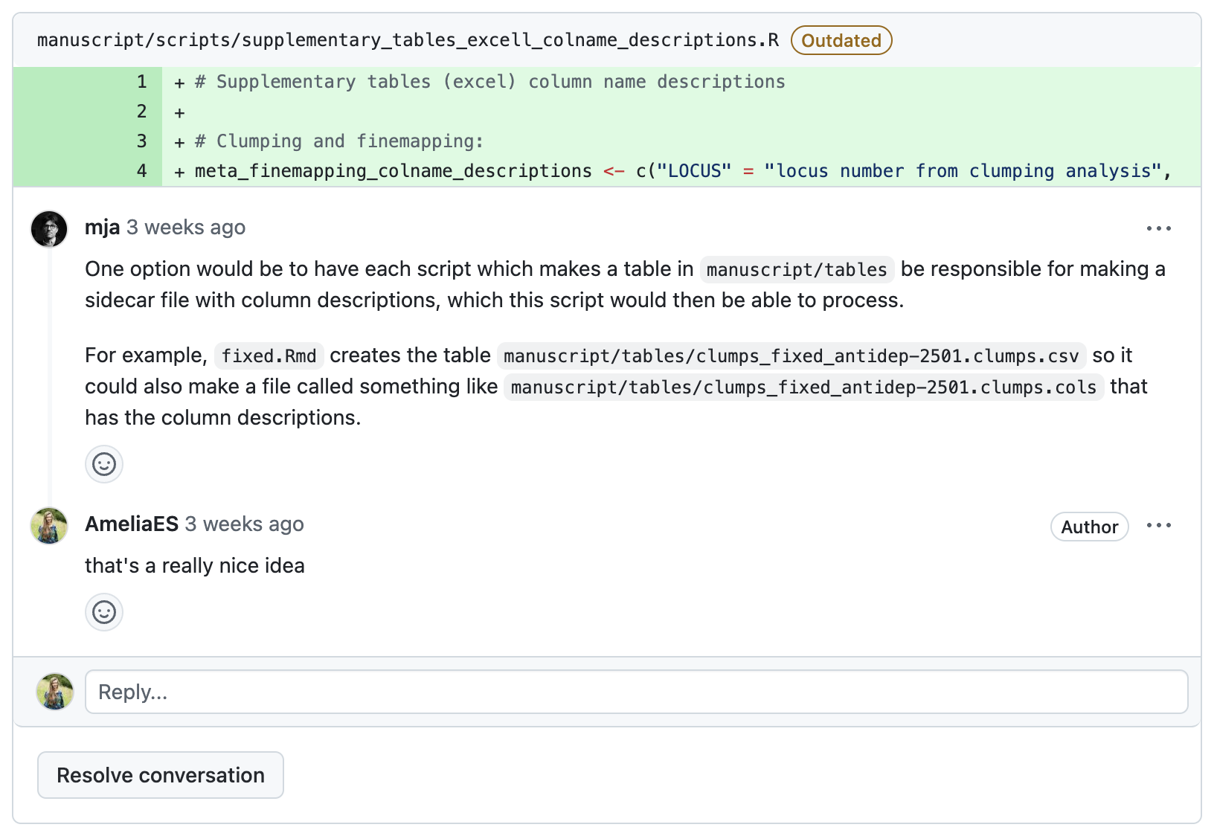
2. Solve problems together
10/18

Slide 13
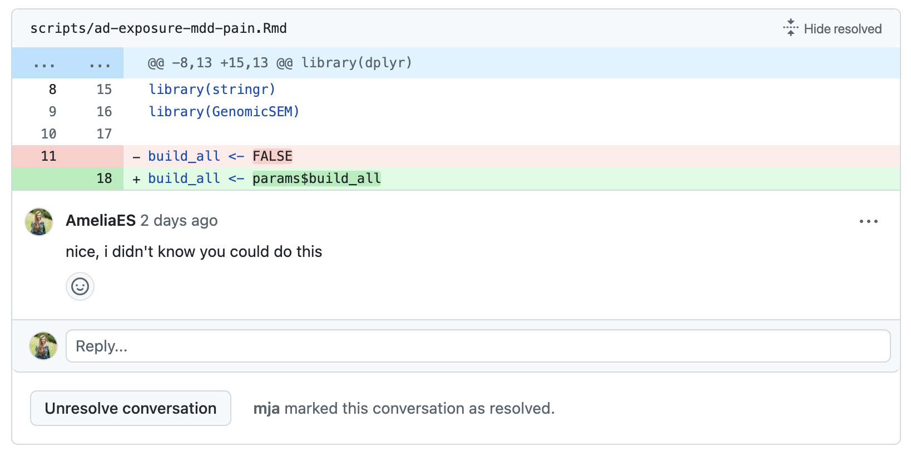
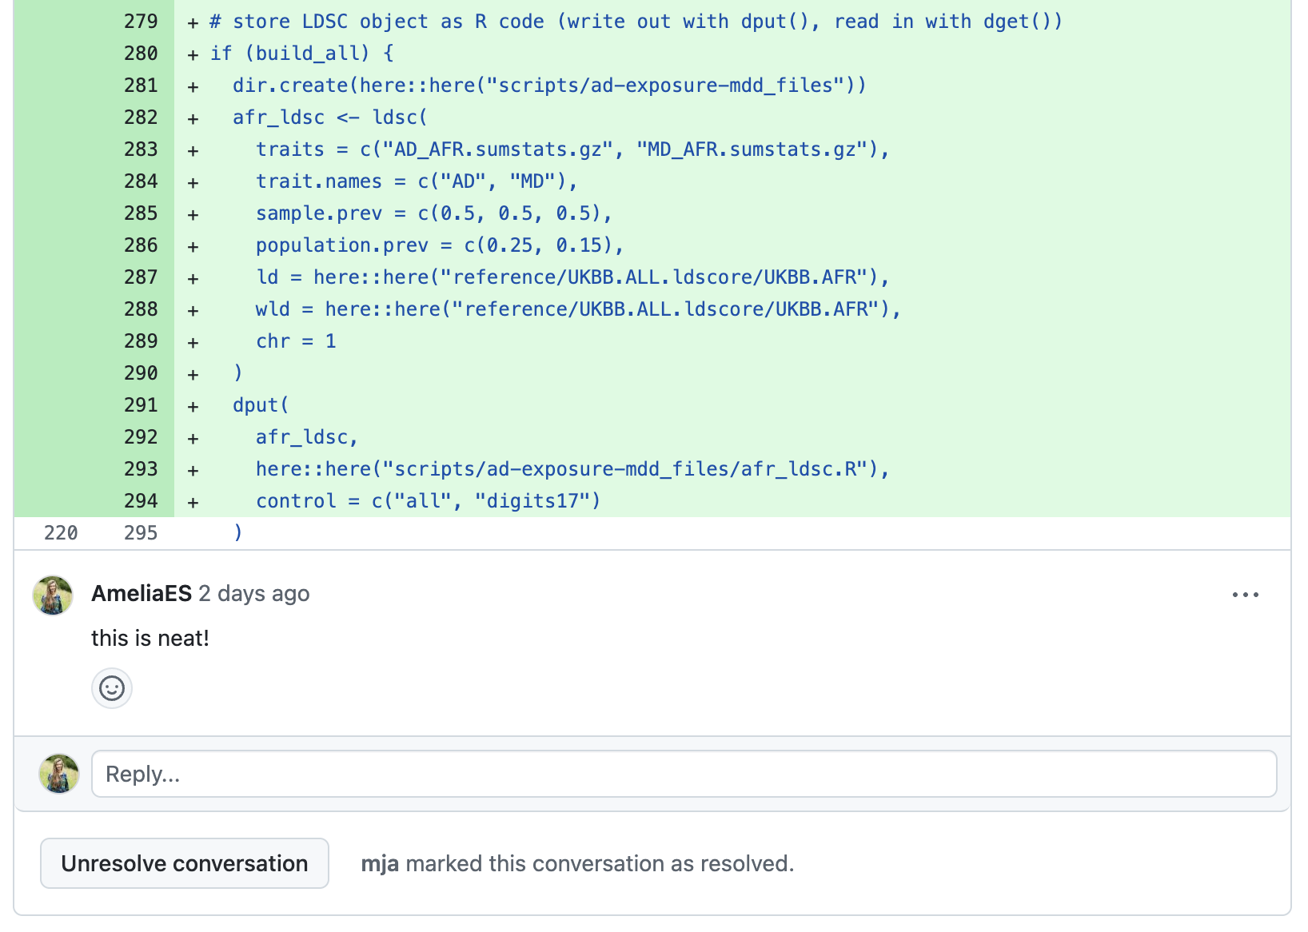
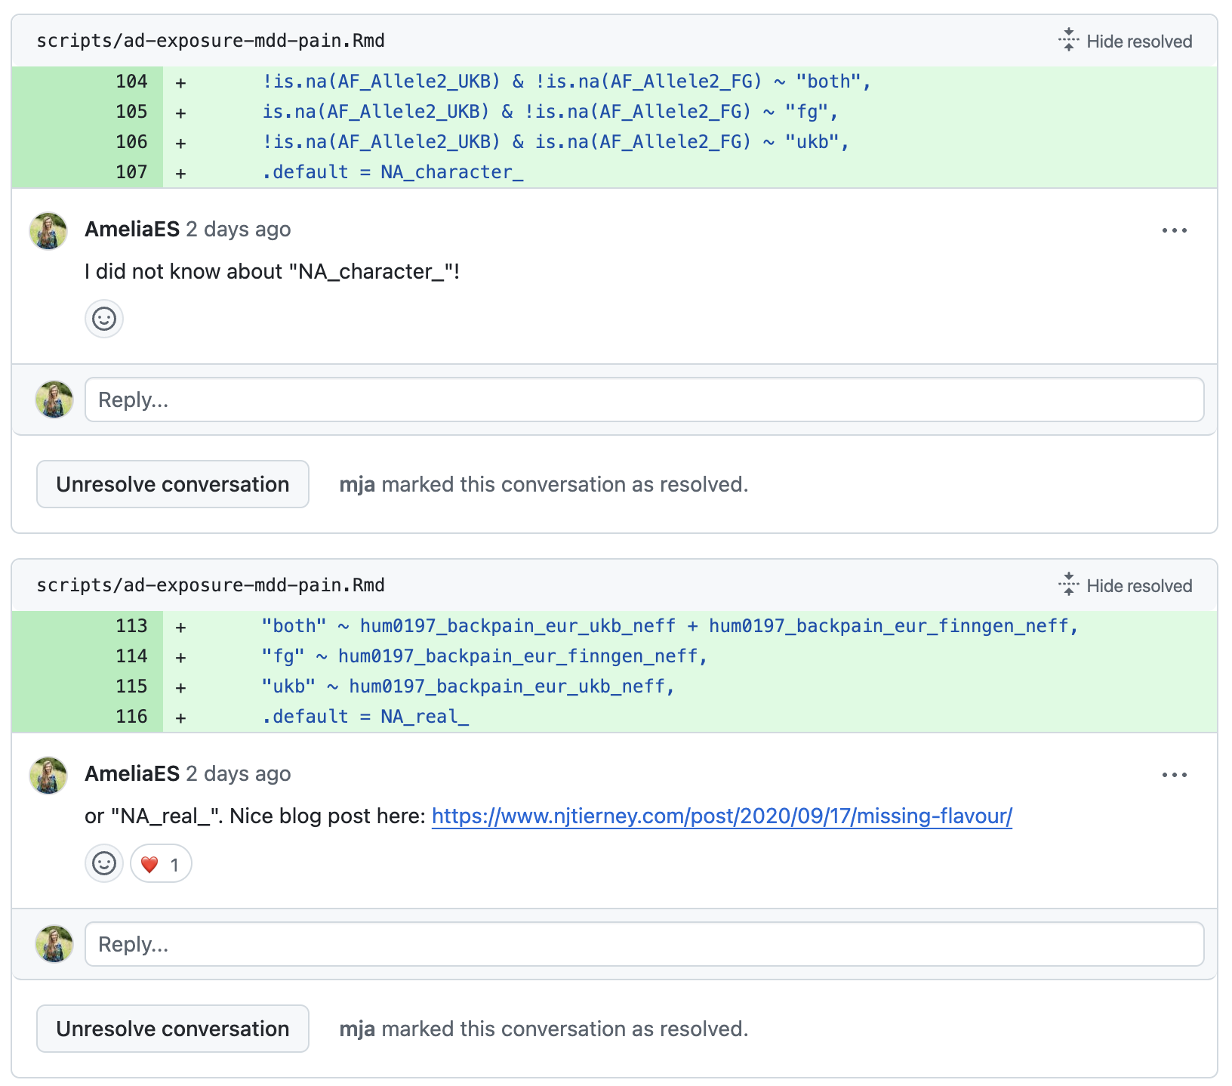
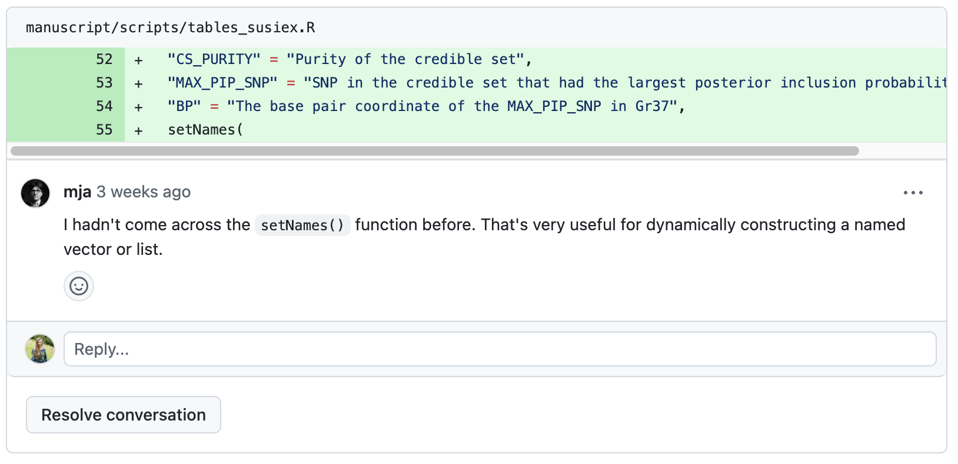
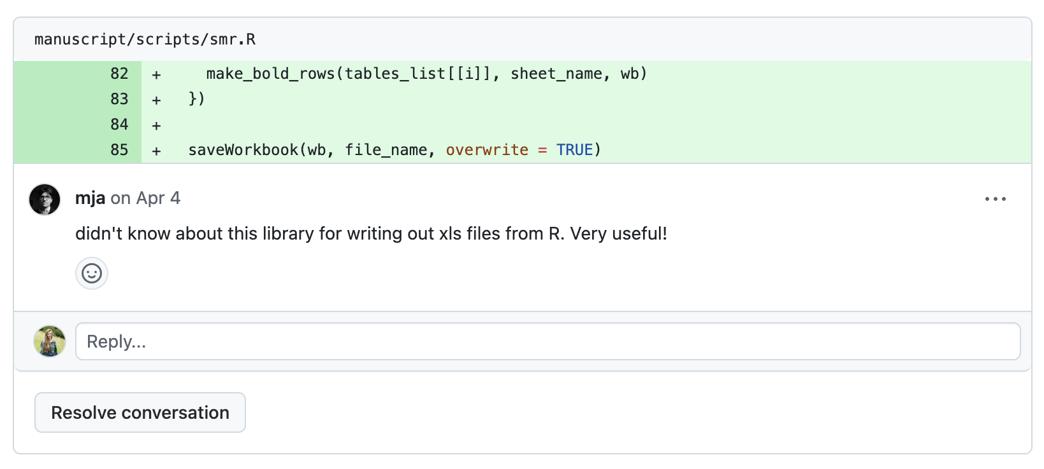
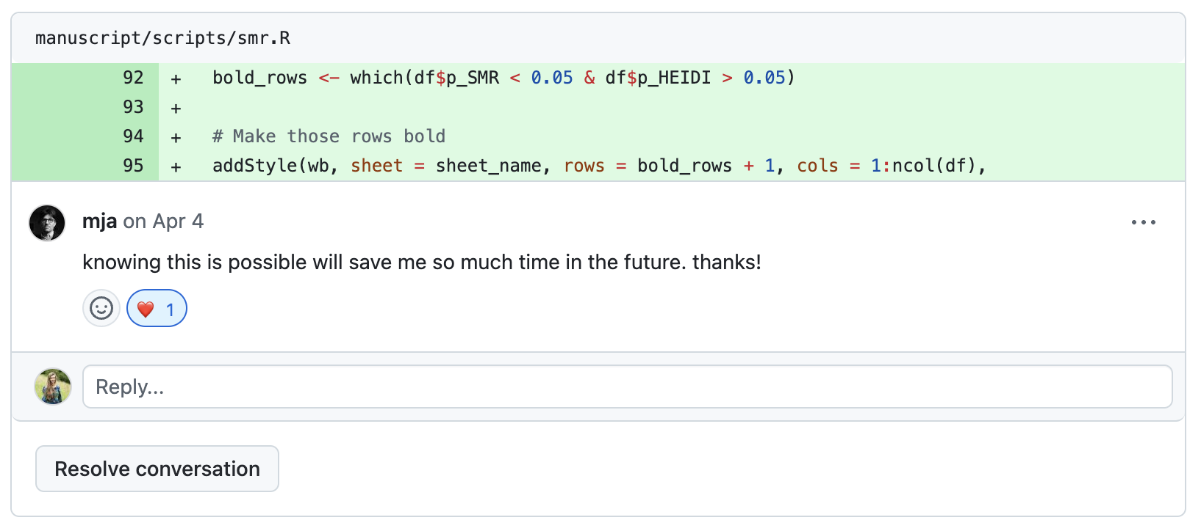
3. Opportunity to learn
11/18

Slide 14
Why code review is worth our time
Improve code quality → research quality
Solve problems together
Opportunity to learn
Writing modular code
Code review
12/18

Slide 15
Writing modular code
breaks down large code into smaller pieces
makes code easier to
understand, reuse, and maintain
13/18
Notes:
Modular code means organizing your script into small, reusable chunks (functions).

Slide 16
# read in data
data <- read.csv(“path/to/data.csv”)
# inspect data
head(data)
min_val <- min(data$variable)
max_val <- max(data$variable)
missing_n <- sum(is.na(data$variable))
summary <- data.frame(min_val, max_val, missing_n)
summary
# FINAL SAMPLE: remove missing values
data <- data[!is.na(variable), ]
# convert to long format
dataLong <- pivot_longer(data, ...)
# Save clean data
write.csv(dataLong, “dataL.csv”, ...)
read_data <- func(path){...}
get_min_max <- func(data, var){...}
count_missing <- func(data, var){...}
remove_missing <- func(data, var){...}
convert_to_long <- func(data){...}
write_data <- func(data, path){...}
write_log <- func(...){...}
main <- func(paths){
data <- read_data(path)
write_log(get_min_max(data),
count_missing(data))
data <- remove_missing(data)
dataLong <- convert_to_long(data)
write_data(dataLong, path)
}
main(paths)
14/18

Slide 17
Why write modular code?
Lots of scrolling and copy-pasting
Running code in bits, out of order
Creates many global/environment variables that can break downstream
Messy, hard-to-read scripts
Difficult to understand at a glance
Harder to maintain, debug, and test
easy to: reuse
test
debug
maintain
Coding challenge: next time you write a script, try writing it as a series of functions with a main() function. Tip: your IDE’s debugger will come in handy!
15/18
Notes:
Lots of scrolling, copy-pasting, re-running bits not in order
Creates environment variables, which can break downstream code if you change them
Code looks quite messy
Not easy to understand what the script does from a quick scan through
Messy code is also harder to maintain, debug and test

Slide 18
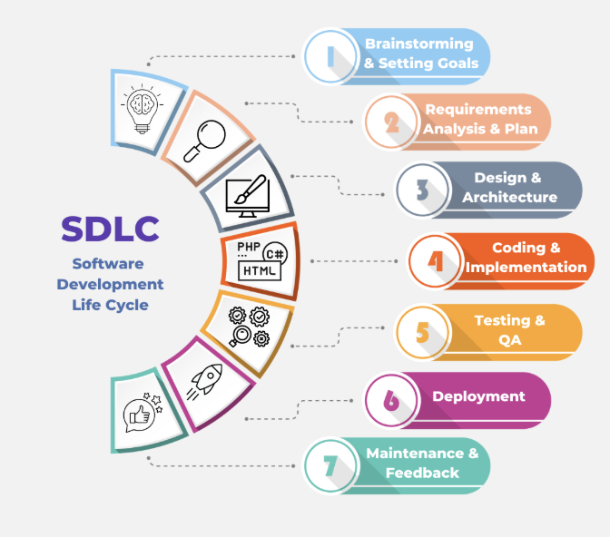
Can we improve code quality by thinking like a software developer?
Code review &
Writing modular code
16/18

Slide 19
Summary
Writing good quality code is important for research integrity
This can be achieved by working together and reviewing code
Start small, some code review is better than none
Writing modular code is easier to understand and debug
Refer to the software development lifecycle to learn more
17/18

Slide 20
Shameless plugs
All welcome at our monthly coding club
Sign up to mailing list: coding-club-psychiatry@mlist.is.ed.ac.uk
Code Review Workshop II
I’m open to Research Software Developer opportunities
Do you have an idea of software/tool you want to develop?
Do you want to write a research grant together?
18/18

Slide 21
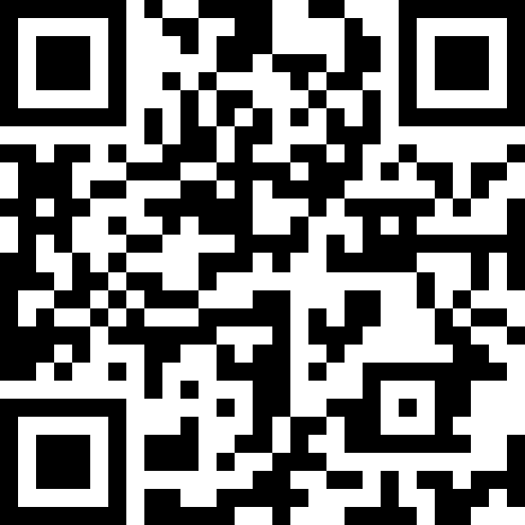


Thanks for listening!
Scan QR code for contact details, slides and links:
amelia.edmondson-stait@ed.ac.uk
Thanks to colleagues that support coding club: Mark Adams, Emily Ball, Hannah Casey et al.
Last slide, I promise!

